Slide 1
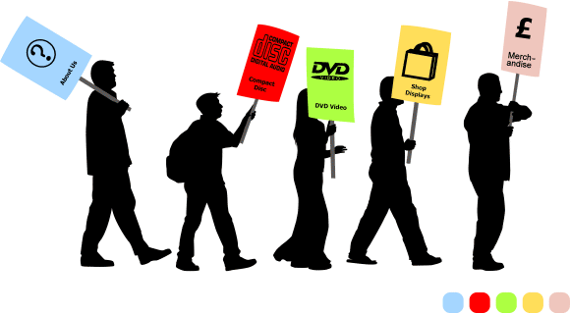
Indirectness in Persuasive Messages
Chapter – Eight
Teacher – Shahed Rahman

Slide 2
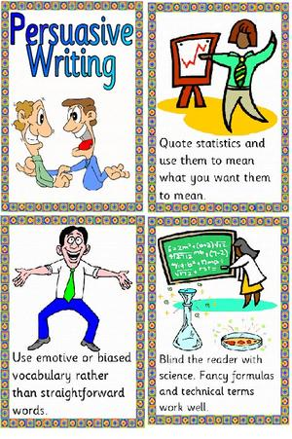
Persuasive
Persuasive messages are appropriately written in indirect order
Achieving the change requires indirectness
Require a slow and deliberate approach

Slide 3

General Advice
Know Your Readers
Choose and Develop Targeted Reader Benefit
Make Good Use of Three Kinds of Appeals
Logic ( Logos)
Emotion ( Pathos)
Character of the Speaker (Ethos)
Make it Easy for your Readers to Comply

Slide 4
PERSUASIVE REQUESTS
Determining the Persuasion
Gaining Attention in the opening
Presenting the Persuasion
Making the Request Clearly and Positively

Slide 5

PERSUASIVE REQUESTS
Determining the Persuasion
Strategy that will convince your reader
Plan the persuasion that will overcome the reader’s objections
Many persuasive appeals may be used- money rewards, personal benefits, good will and so on.

Slide 6

PERSUASIVE REQUESTS
Gaining Attention in the opening
Writing to a person who not invited your message and probably does not agree with your goal
The opening sets the strategy and gains attention
Attention is needed to get the reader in a mood to receive the persuasion
What you write to gain the attention is limited only by your imagination

Slide 7
PURSUASIVE REQUESTS
Presenting the Persuasion
Present the points convincingly (selecting words for effect, using you viewpoint, and the like)
Making the Request Clearly and Positively
Follow the Persuasion with the request
Word the request for best effect
Do not use a negative tone
Be positive
The request can end the message or be followed by more persuasion
Ending with a reminder of the appeal is also good

Slide 8
SALES MESSAGES
Questioning the Acceptability of Sales Messages
Planning the Structure
Knowing the product or Service and the Reader
Determining the Appeal
Determining the Mechanics
Gaining Attention
Holding Attention in the Opening
Presenting the Sales Material
Stressing the You View Point
Choosing Words Carefully
Including All Necessary Information
Driving for The Sale
Urging the Action
Recalling the Appeal
Adding Postscript
Inviting Name removal to Email Readers

Slide 9

Questioning the Acceptability of Sales Messages
Direct mail sales messages are not always well received
Email sales messages are even more unpopular and for good reason
Permission email marketing is emerging
Techniques have not yet developed

Slide 10

Planning The Structure
Usually Brochures, leaflets, a letter, and such combine to form a sales mailing
Email sales emphasize the basic message but use support information

Slide 11

Knowing the Product or Service and the Reader
Studying product or service to be sold
Study your readers
Research can help you learn about prospective customers
If research is not possible , use your best logic

Slide 12
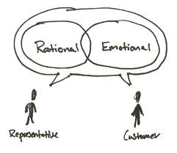
Determining the Appeal
What appeal and strategies to use
Appeal may be emotional ( feelings)
May be rational ( reason)
Select the appeals that fit the product and the prospects

Slide 13
Determining the Mechanics
Writing sales messages involves imagination
Makeup of sales messages differs somewhat from that of ordinary messages
Email sales messages can use all the creativity that computers can produce

Slide 14

Gaining Attention
Gain attention
With direct mail attention begins with envelope
With email it begins with from, to , subject, fields
Be honest
Make the subject line clear and short
Avoid sensationalism

Slide 15
Holding Attention in the Opening
Opening sentence should hold attention and set up the strategy
Rational appeals stress logic
Summary message are also effective

Slide 16
Presenting the Sales Material
Plans vary for presenting appeals
Emotional appeals usually involve creating an emotional need
Rational appeals stress fact and logic
Sales writing is not ordinary writing

Slide 17

Stressing the You – View point
Important in sales writing so use it ☺
You will enjoy our hot salsa
You may choose from three lovely shades
Choose the word carefully
Igloo ice cream has nine grams of fat per serving
Igloo ice cream is 95 percent fat free

Slide 18

Including all Necessary Information
Give enough information to sell
Answer all questions
Overcome all objections
Coordinate the sales letter with accompanying booklets, brochures, and leaflets.
Make the letter carry the main sales message
In email supporting information can be accessed through links or attachments

Slide 19
Driving for the Sale
After you caught up the readers attention ----End with drive for the sale
Urging the Action
Urge action now –
Example –
To take the advantage of this three day offer
So that you will be the first in your community
Recalling the Appeal
Recalling the appeal in the final words is good technique

Slide 20
Adding Postscript
Postscripts are acceptable and effective
Example = Hurry! Save while this special money saving offer lasts
Inviting Name removal to Email Readers
Offer to remove reader from mailing as a courtesy gesture

Slide 21

Can you sell now ?
Consider how you will sell the pen that you are using now ?
Rational or Emotional?
How you will start selling ?
Word “sell” can trigger strongly negative to the person you are trying to sell.

